Slide 1
meetchewthere
CONCEPT VIDEO

Slide 2
Feed Your Social Cravings
Dietary restrictions and social eating are not mutually exclusive, but too many people allow their food allergies to restrict more than just their diets. Gone are the days of declined invitations, lonely meals, and self-imposed hermitage. meetchewthere redefines social eating for those affected by severe dietary restrictions by building trusted communities of geographically proximate people with common restrictions and providing them with a safe space to create, host, and join social events centered around food.

Slide 3
TASKS
Simple: eat a diet friendly meal
Moderate: share a meal with someone with your same dietary restriction(s)
Complex: build your community by planning/hosting a food centered event for people with your same dietary restriction(s)

Slide 4
STORYBOARD
Characters:
Frustrated Gluten-Free Person - Lindsey (L)
Gluten-Free Diner at Coho - Senthil (S)
Lonely Gluten Free Diner - Jesse (J)
meetchewthere app - Clay (C)
group of gluten-free people - random guys from KA
Locations
Room with a chair and a desk - shot in KA
Restaurant w/ gluten free menu - shot at Coho
Outside dining area - shot at Tressider
picnic and bbq area for the gluten free event - shot at the KA backyard

Slide 5
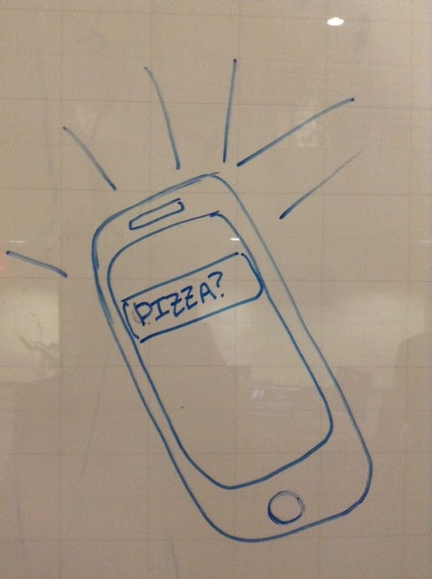
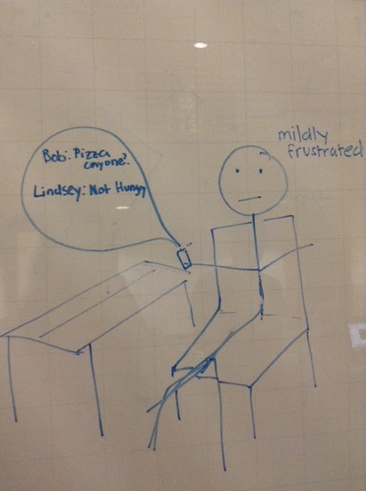
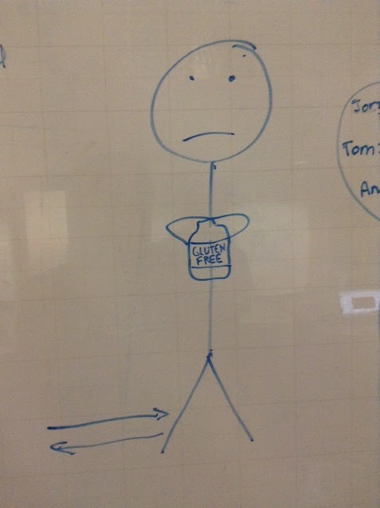
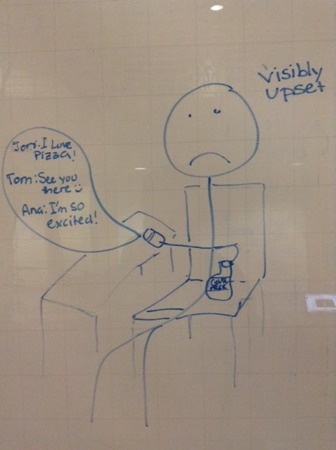
Simple Task - Get a Safe Meal
opens (music playing) with a close up of a phone receiving a message
zoom out as L picks up to read the message
she responds, puts the phone down, sits back mildly frustrated
door opens straight to close up of GF labeled food package
pan out to see L carrying GF snacks back into the room
sits back down w/ the food, picks up the phone and reads three more messages as she eats
does not respond
puts the phone face down on the desk and continues to eat clearly upset
Notes:
text messages will appear as text on screen - green in upper left for received and red in lower bottom for sent
iphone send and receive sounds when text appears
only other sound is total eclipse of the heart instrumental

Slide 6
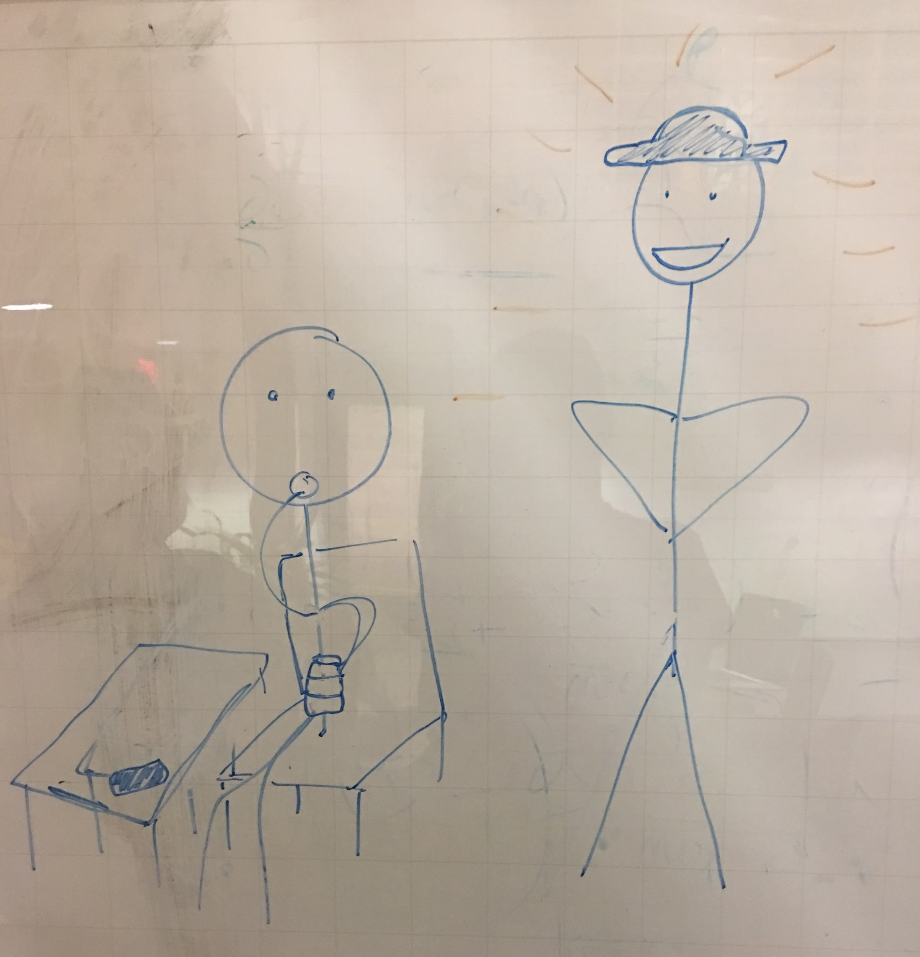
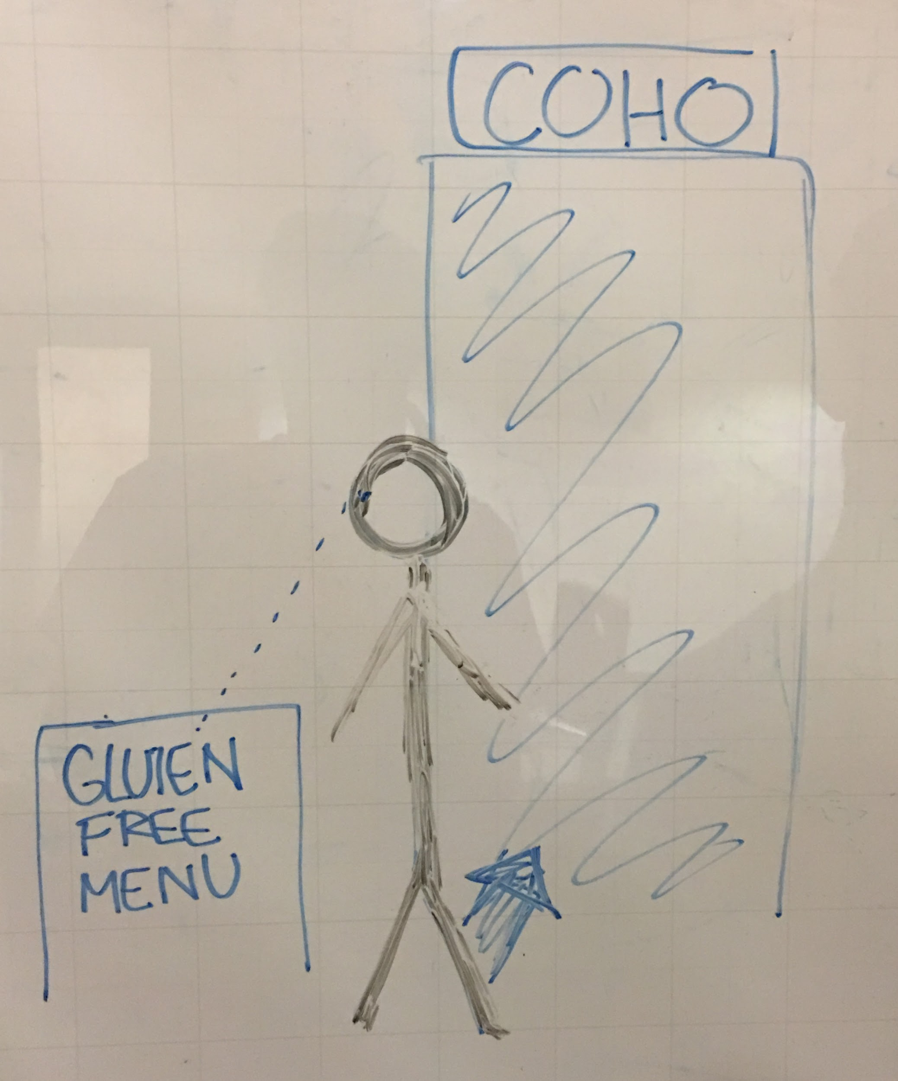
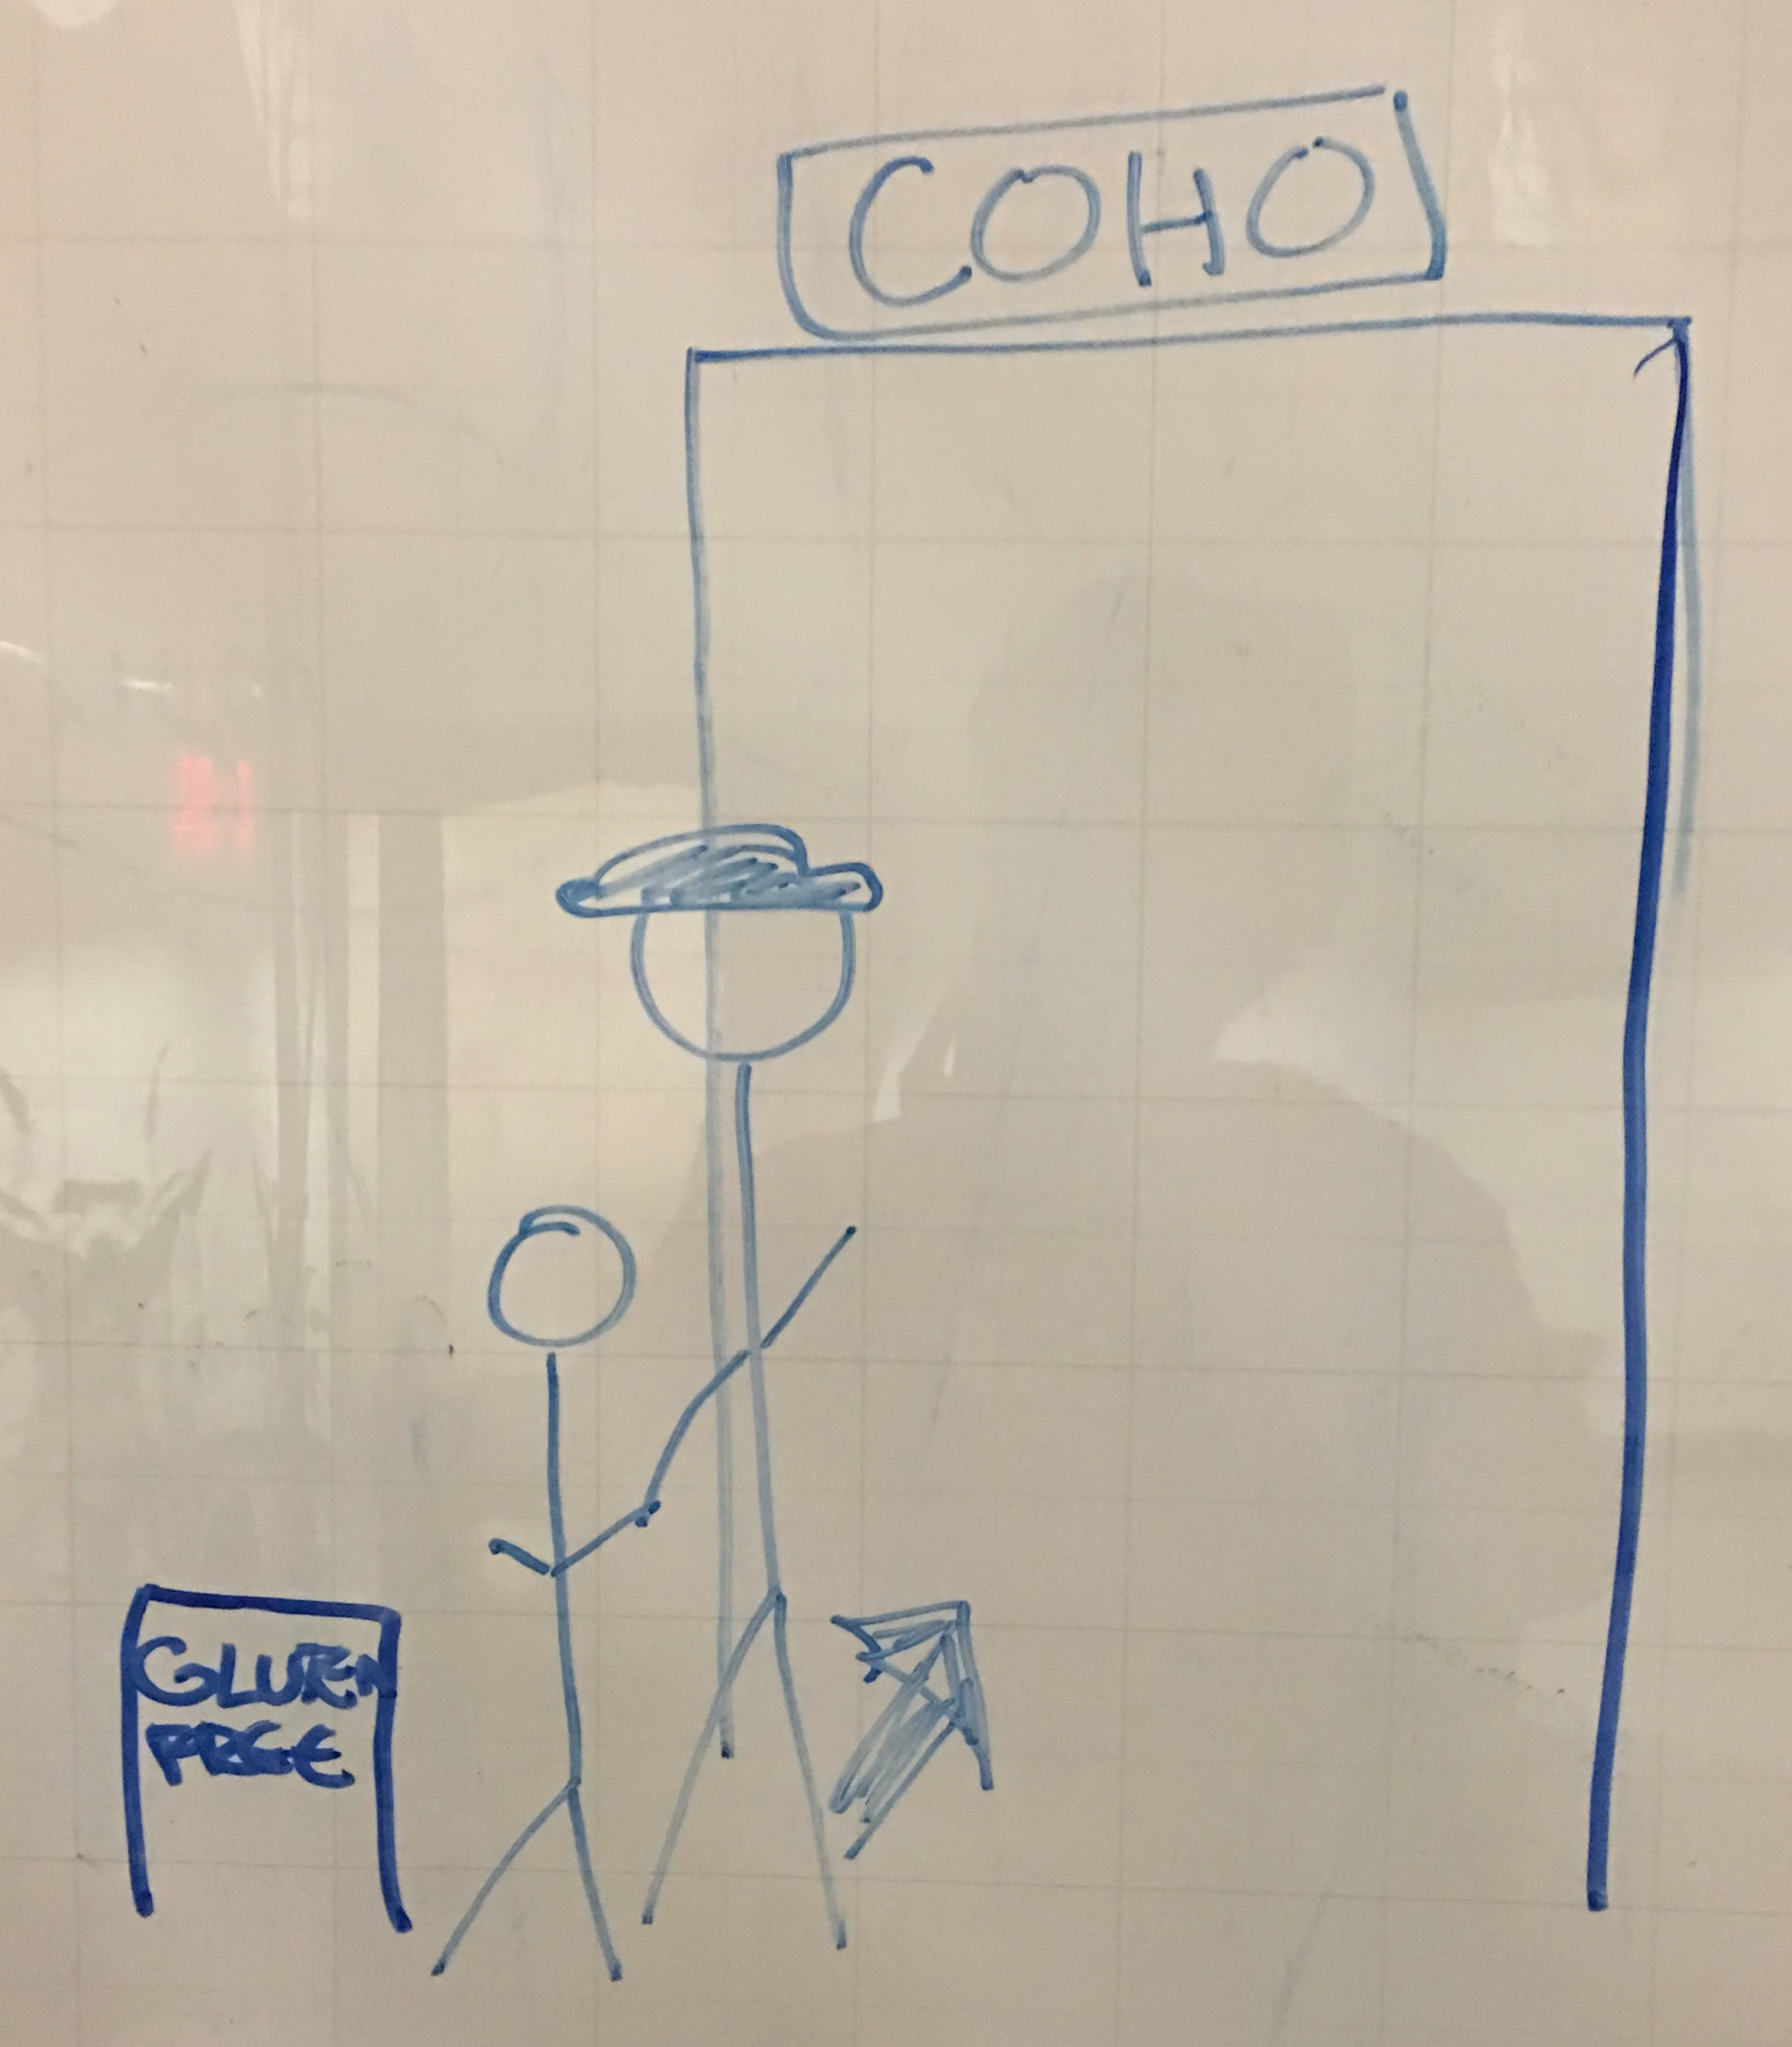
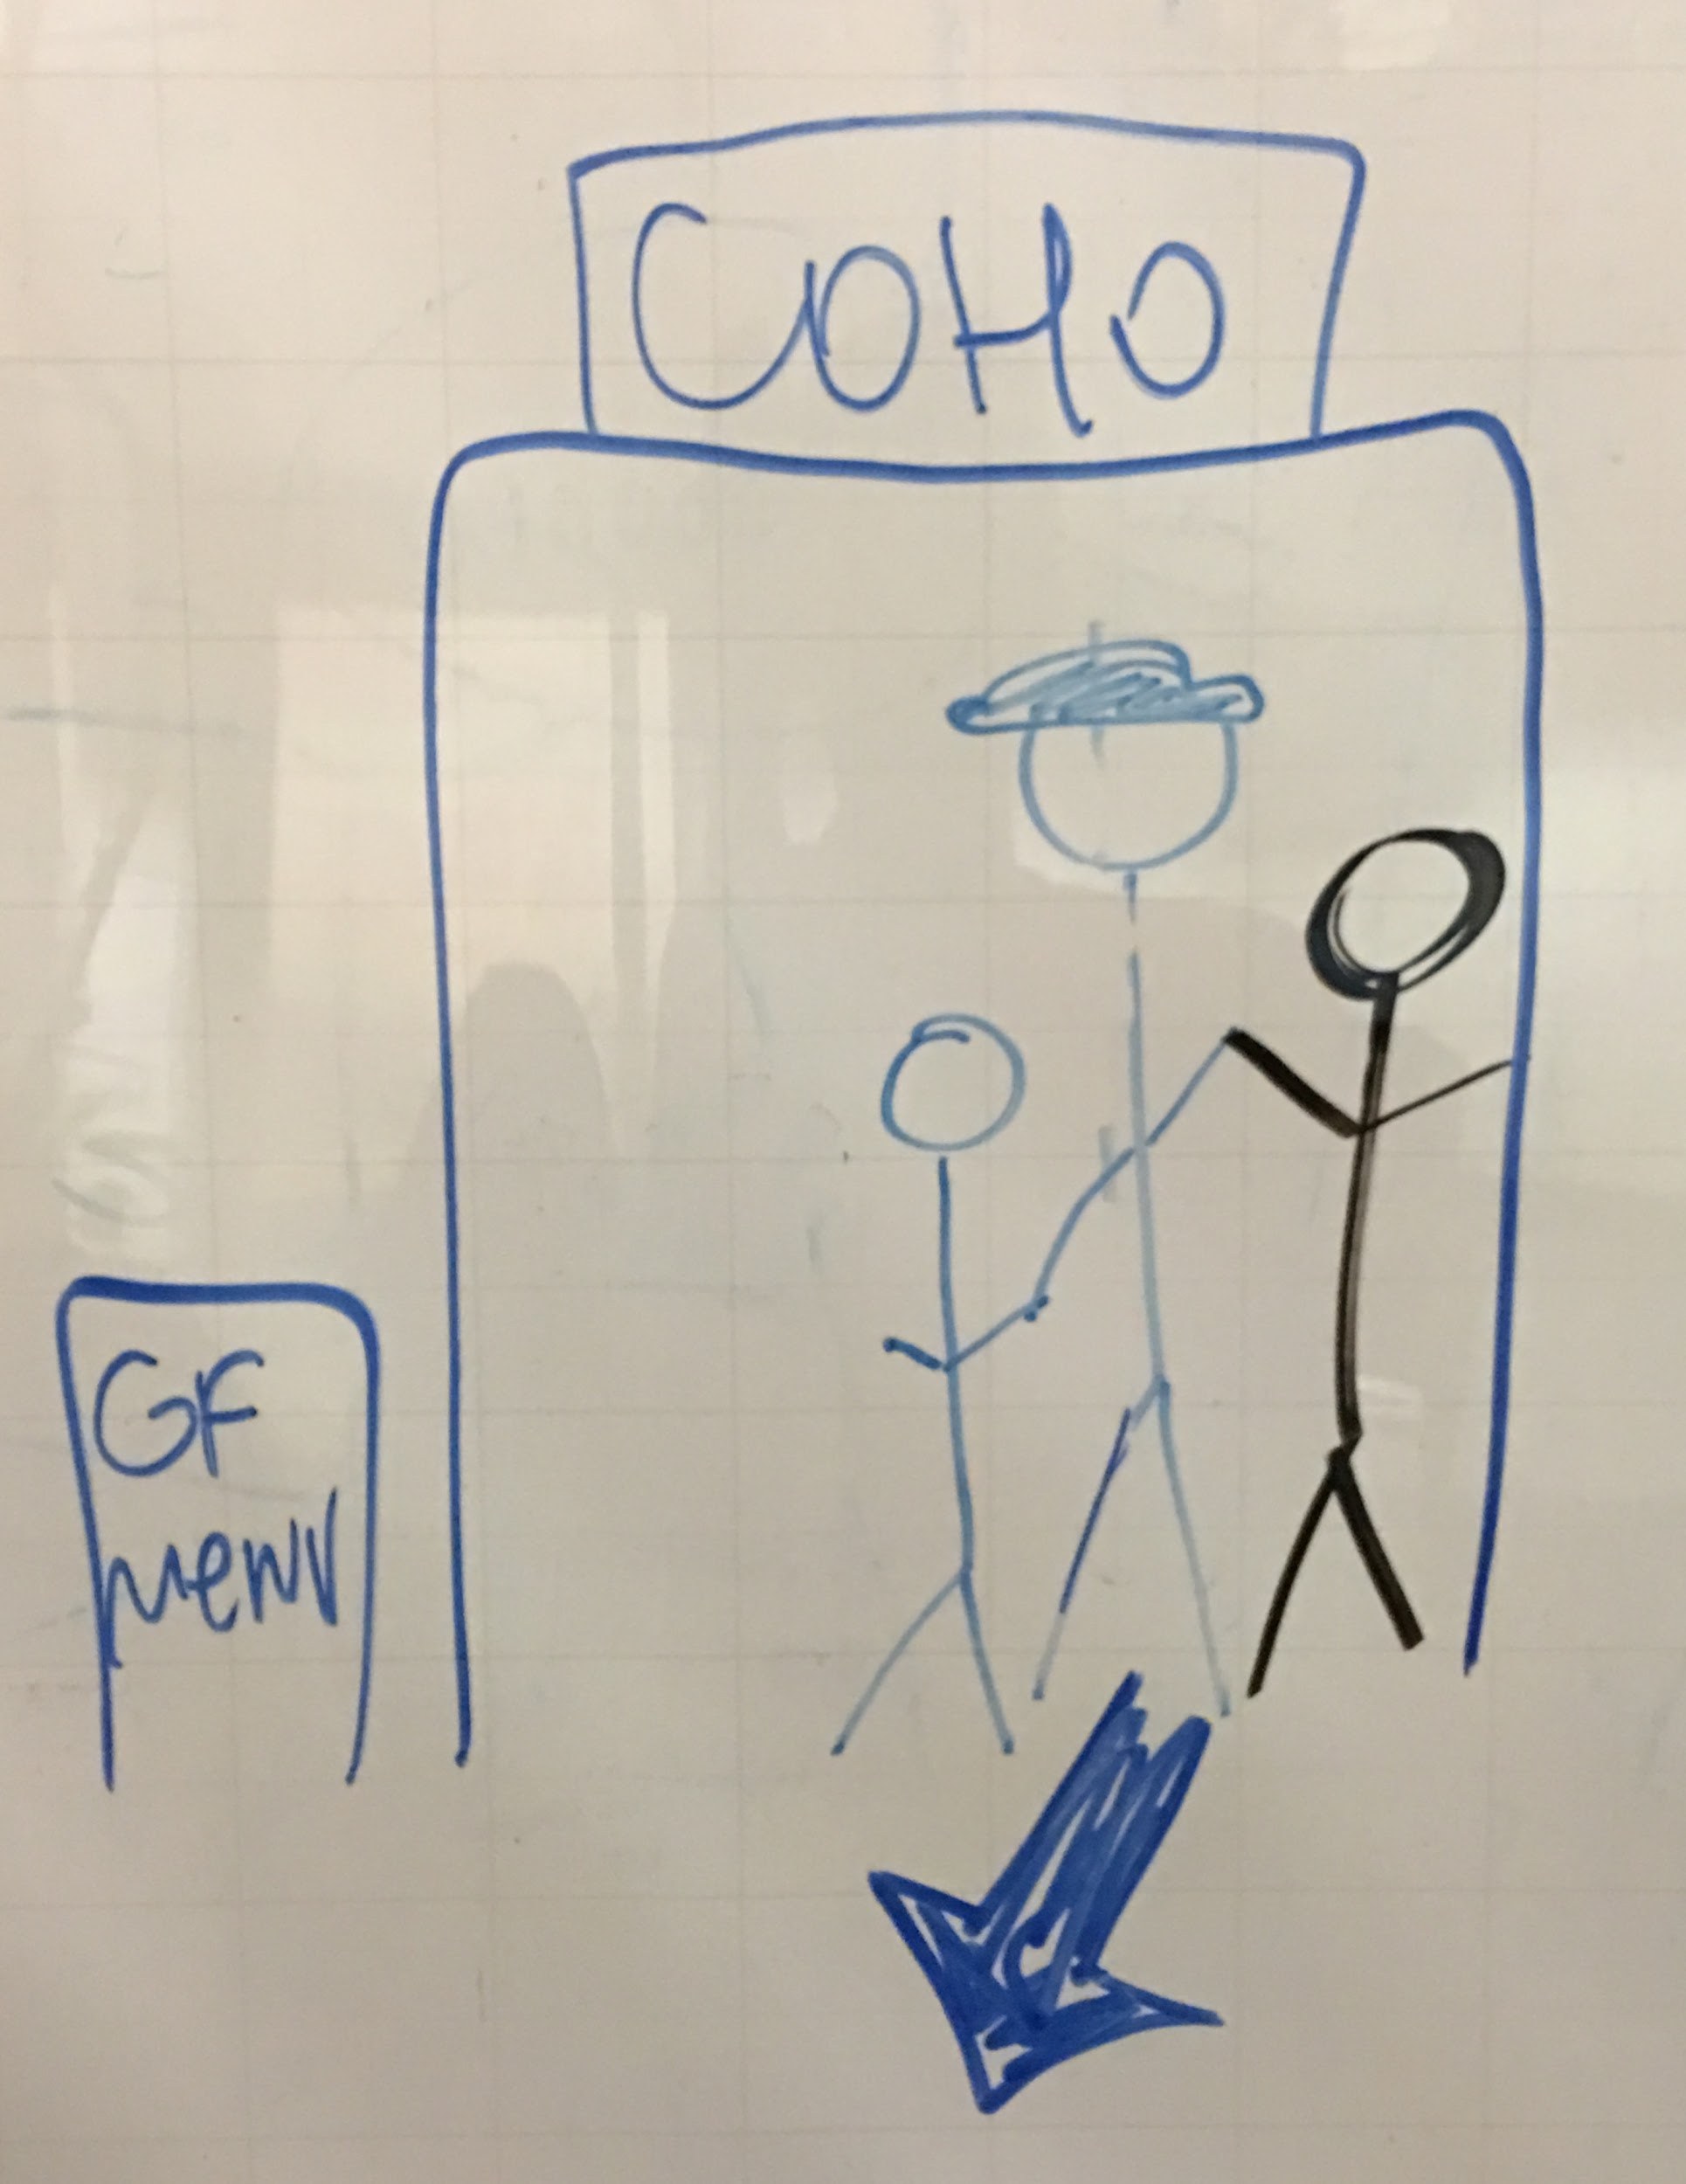
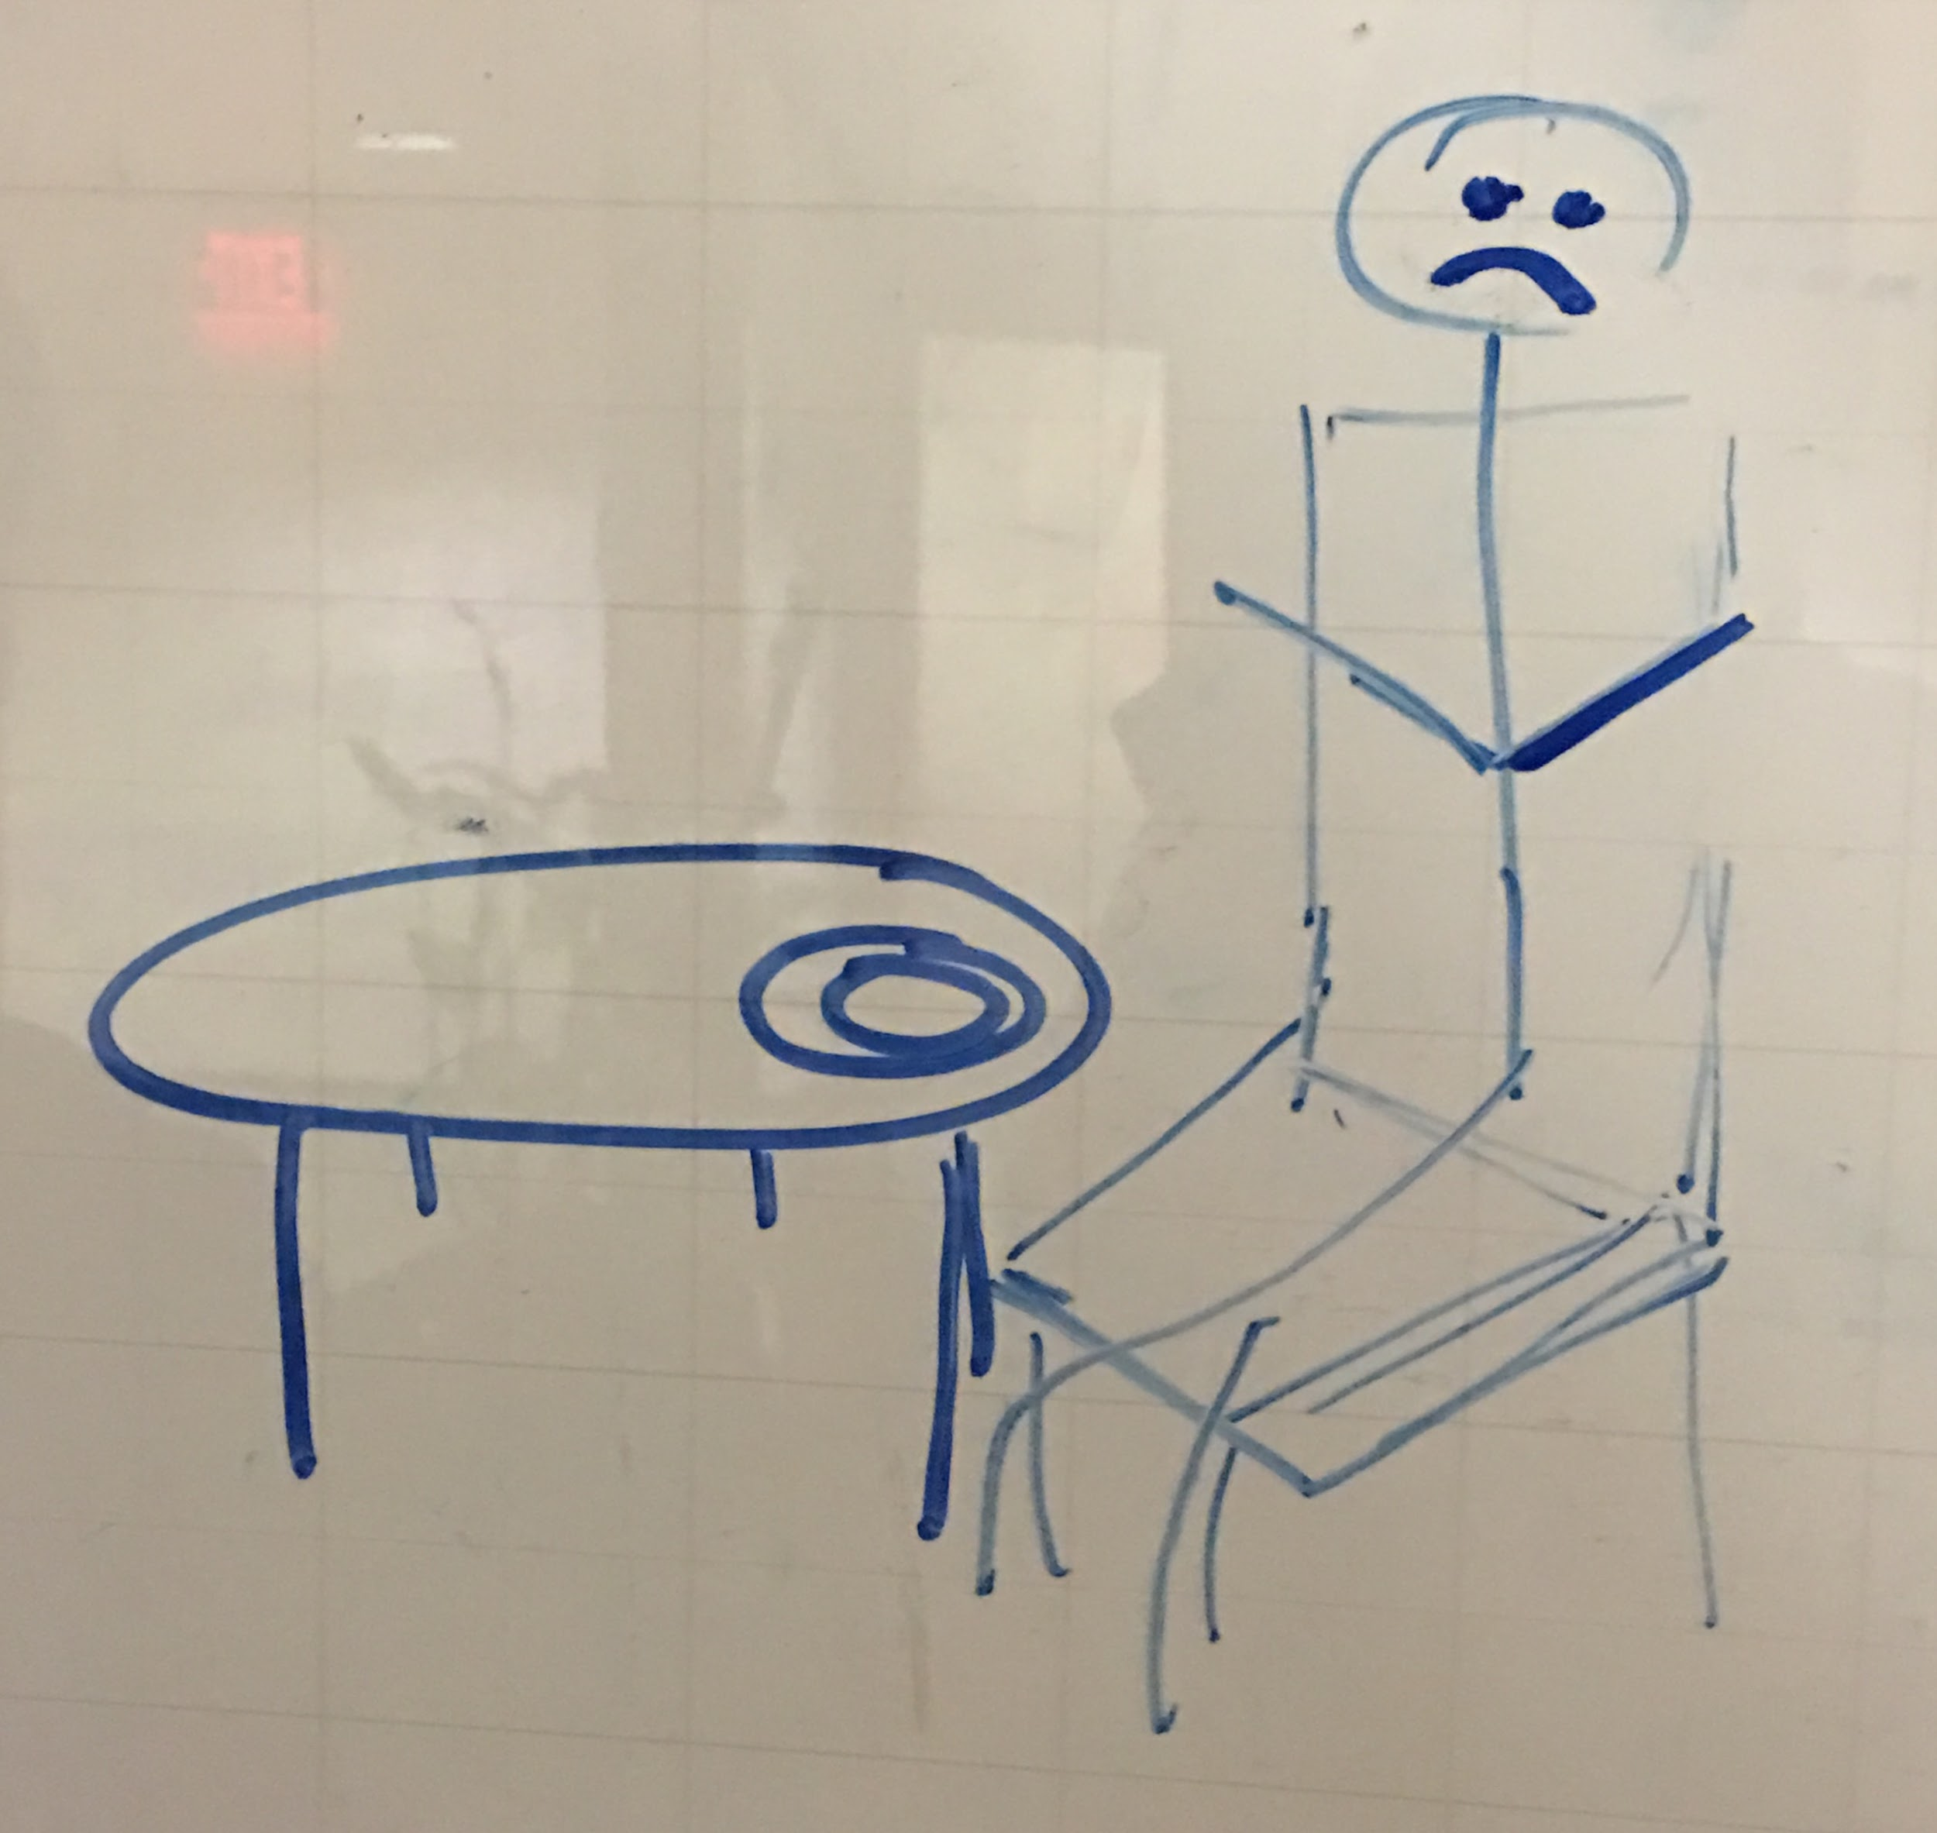
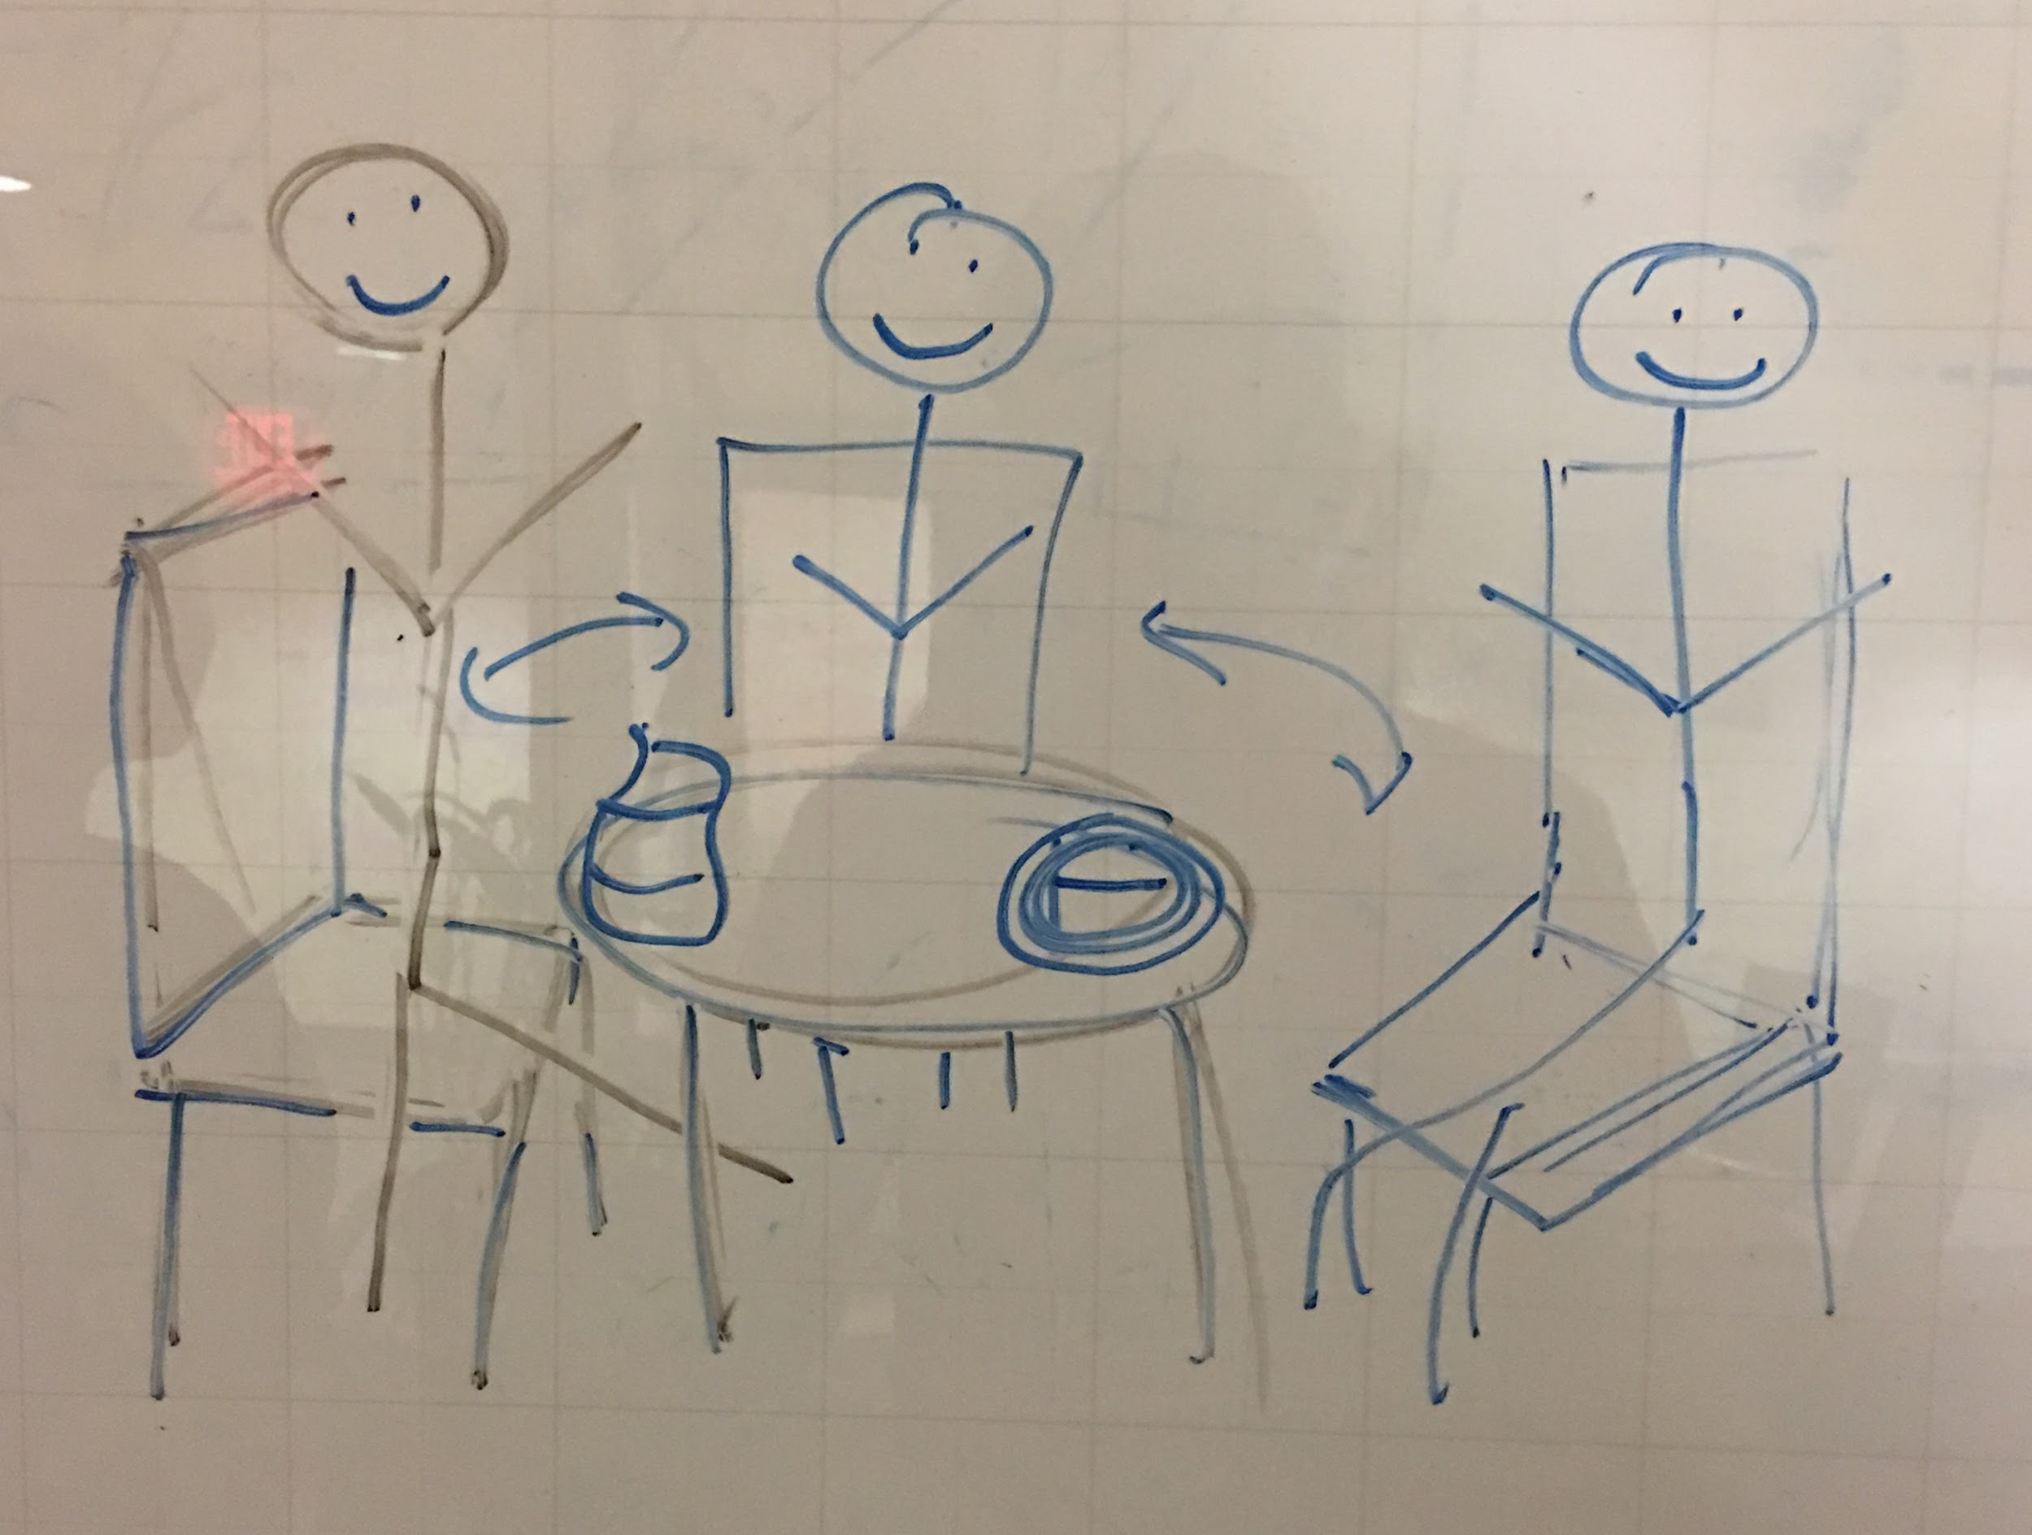
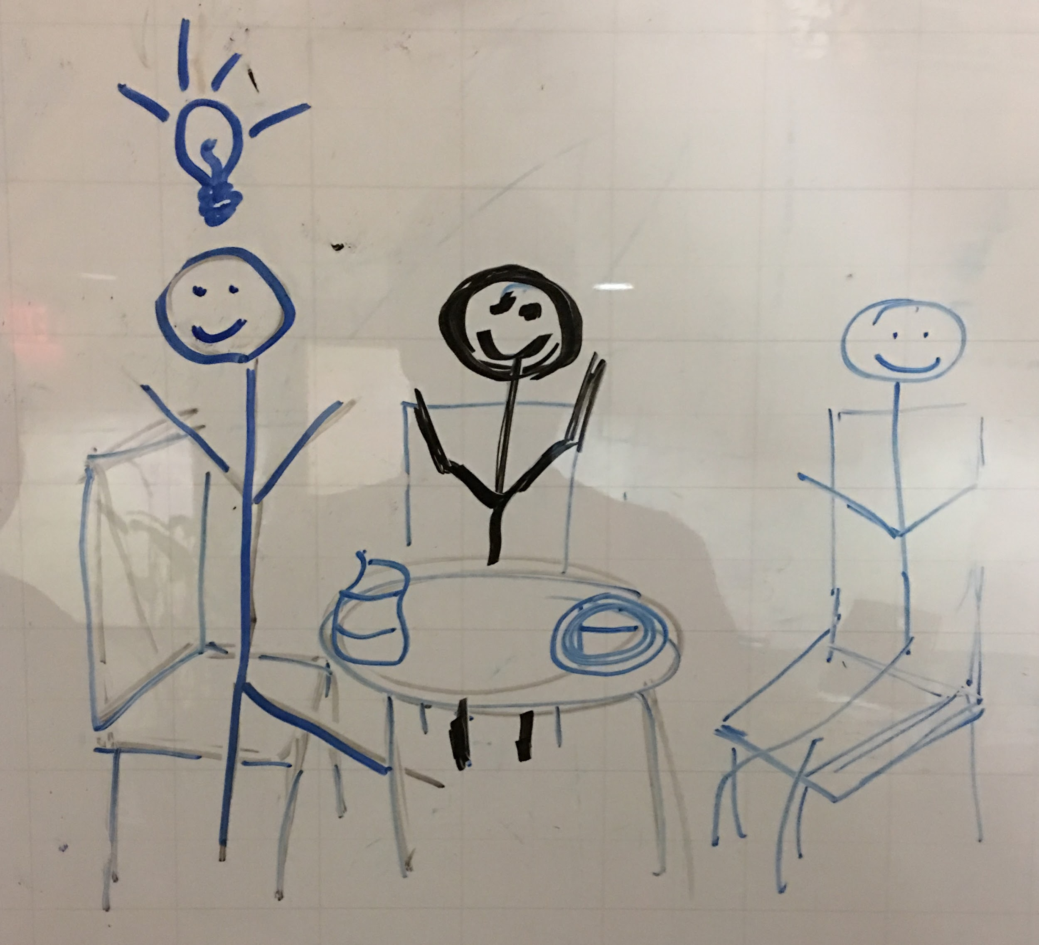
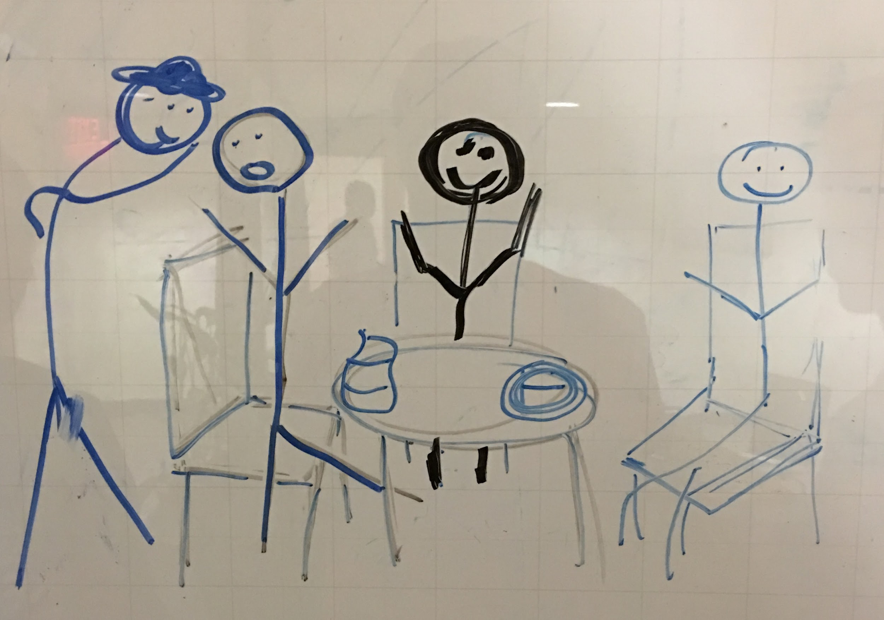
Moderate Task - Share a Meal
Notes:
music stops and fanfare plays when C appears
switch to upbeat music
thoughts during the group brainstorm will show as text at the bottom of the shot
music hits a climax and cuts once the plan is set in motion
Clay appears in the doorway
flash back to L in the chair, looks at him skeptically
camera stays on L, C pulls her out of the door and the shot
open to a GF Menu sign next to the open door
Senthil walks into the left side of the shot, he reads the sign keeping his back to the camera, then walks in the door
C runs into the left side of the shot, pulling L by the arm, past the menu and follows S through the door
Same camera angle, C reappears through the empty door pulling L who is now pulling S - they run out the door, towards the camera and out of the shot
open to close up of J eating alone out of a gluten free labeled dish
pan out as C leads S and L into the shot, S shakes J’s hand, they sit and L offers them both some of her food
L, J, and S brainstorm how they could meet others with their same diets
L has an idea, she calls C and whispers her plan

Slide 7
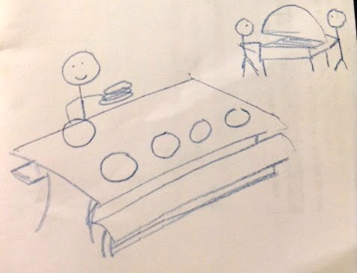
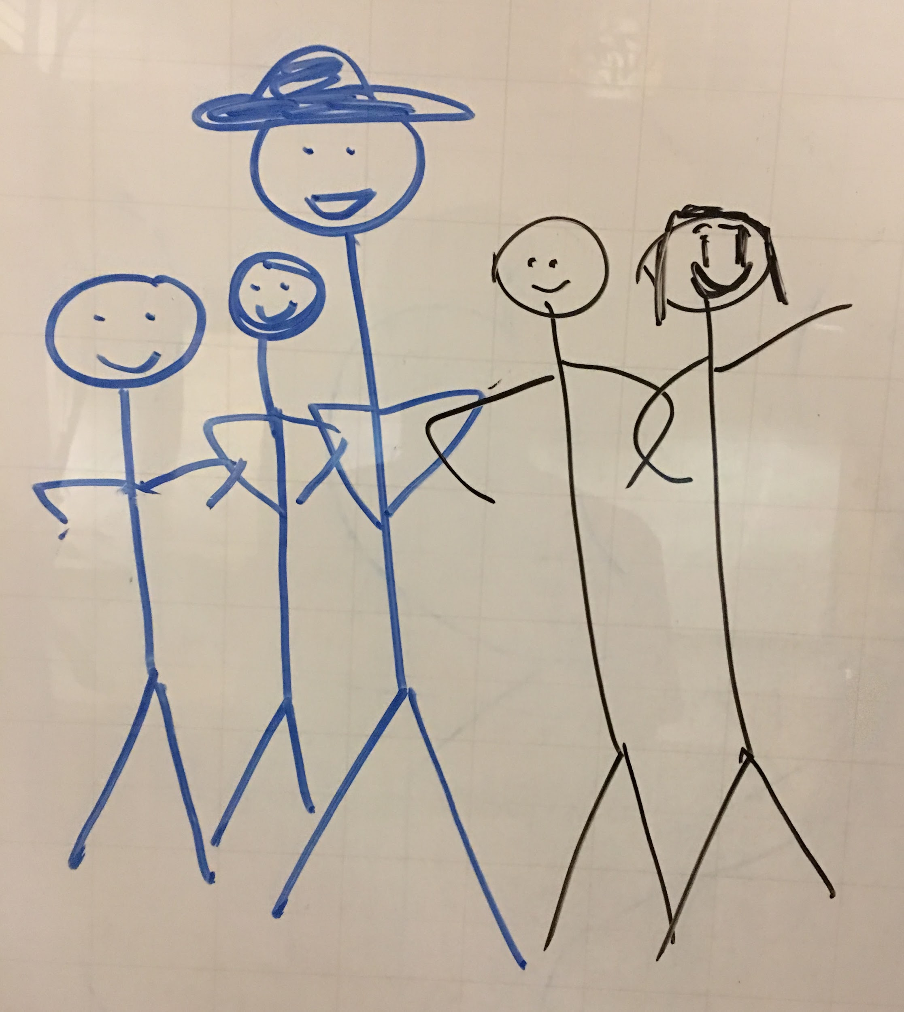
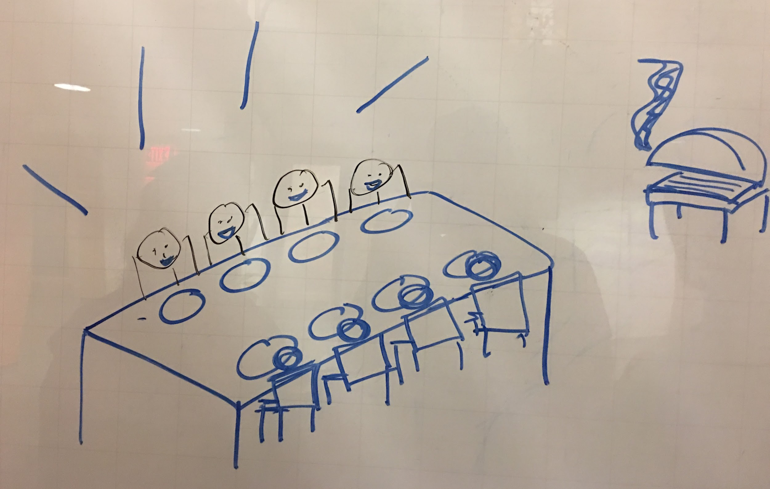
Complex Task - Plan and Host a Food Event
opens to a pan of an outdoor picnic/bbq area
S is setting the table with plates cups; J and L are manning the bbq further off
camera switches to C leading a group of guys up a hill
they walk slowly and confidently towards the camera
Notes:
music switches as scene opens
song plays until it fades out with the last picture
everyone is now sitting at the picnic table set by S
they are talking, laughing and raise their glasses as the camera zooms out
fade to black then flash the product name and value prop

Slide 8
meetchewthere concept video

Slide 9
THANK YOU

Slide 10
INDEX
NEEDFINDING 3.0 - What are they saying online?
What solutions exist?
Why are these solutions NOT working?

Slide 11
People Want to Eat Socially but Safely
“I don’t go to events without eating first anymore. I bring my own food and eat in the car until I am stuffed. Or better yet, call and say I’m going to be a few hours late and for everyone to start without me. Then show up only an hour late, and make sure to have eaten.”
“I started not being invited to holiday gatherings”
“I cannot wait to walk up to the window and order my meal and not have to explain my condition, without the funny looks or ridiculous comments, or stupid questions. Oh to feel like a normal person again!”
“I recently celebrated a milestone birthday. I went out to dinner with a friend and took my own dinner roll with me”
“I bring my whole Thanksgiving dinner to sister’s house”
“My family and closest friends understand, but I miss out on parties, dinners at restaurants and friends’ homes, and forget weddings”

Slide 12
People Want Someone Who Understands
“I am so sick of trying to explain to people about contamination and if your kitchen is not completely safe you should not do any cooking for anyone. No one seems to pay attention.”
“Having to explain gluten-free to family members can be discouraging. Each has their own reaction in addition to me having times when I feel like it’s just too much work to explain how and why.”
“Over the years, the more people look at you like you clearly made it all up just to be difficult, the more you wonder if you might be just crazy!”
“Dating is absolutely the worst! I recently walked out on a date when a guy told me there was no reason I couldn’t eat the salad next to his burger. He insisted it was all in my head. I tried to explain to him, and he told me I’m wrong and he knows what he’s talking about. “

Slide 13
People Want To Do More Than Just Talk
Janetwinva: “I’m surprised Sacramento doesn’t have more places. Have you tried looking at any meetups? You’re quite far from us down here…I hope you find someone soon.”
Cali Celiac: “I have actually researched local meetup groups and haven’t seen any that would apply…”
“I am always willing to get coffee or lunch in Springs, Pueblo or nearby areas. I do not know any other people with Celiac. It would be nice to connect”
“Come on now, there must be at least 1 other person in this area who visits this site. Why can’t I find anyone in my area? How sad am I to have to respond to my own post? Anyone?”

Slide 14
Current “Solutions”
Forums
wide variety of gluten free forums
small number of general allergy forums which sometimes contain specific food allergy channels
Meetup.com
“Meetup brings people together in thousands of cities to do more of what they want to do in life. It is organized around one simple idea: when we get together and do the things that matter to us, we’re at our best. And that’s what Meetup does. It brings people together to do, explore, teach and learn the things that help them come alive."
Dating Sites

Slide 15
These Aren’t Solutions
Forums can be a great place for people to talk about shared problems and experiences but…
a response is not guaranteed - chat activity is sparse and inconsistent
talking ≠ socializing - people still want a way to live their lives outside of their house
Meetup.com is TOO big
people suffering from severe dietary restrictions are a small targeted community. Since meetup.com has an overwhelming number of events and groups, those with dietary restrictions often get lost in the crowd, fail to find a group that fits, and ultimately give up searching.
Dating Sites are focused on just that - dating
there are no platonic friend options

